Slide 1


AWS API Gateway Kole Vasilevski, Principal Software Engineer

Slide 2
API Gateway
Enables developers to create, publish, maintain, monitor, and secure APIs at any scale.
Act as a “front door” for application to access data, business logic or functionality from backend services.
Allows creating, deploying, and managing a RESTful API to expose backend HTTP endpoints, Lambda functions, or other AWS services.
Together with Lambda, API Gateway forms the app-facing part of the AWS serverless infrastructure.

Slide 3
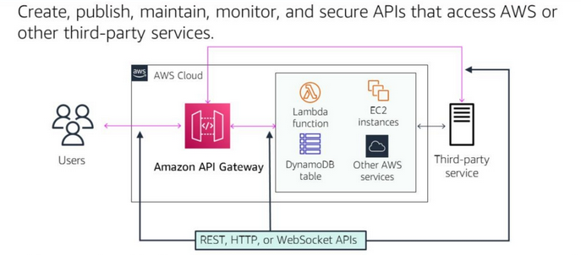
API Gateway Accessing backend services

Slide 4
API Gateway Features
API Gateway can execute Lambda code in your account, start Step Functions state machines, or make calls to Elastic Beanstalk, EC2, or web services outside of AWS with publicly accessible HTTP endpoints.
API Gateway helps you define plans that meter and restrict third-party developer access to your APIs.
API Gateway helps you manage traffic to your backend systems by allowing you to set throttling rules based on the number of requests per second for each HTTP method in your APIs.
You can set up a cache with customizable keys and time-to-live in seconds for your API data to avoid hitting your backend services for each request.
API Gateway offers the ability to create, update, and delete documentation associated with each portion of your API, such as methods and resources.

Slide 5
API Gateway Features
You can create data mapping definitions from an HTTP API’s method request data (e.g. path parameters, query string, and headers) to the corresponding integration request parameters and from the integration response data (e.g. headers) to the HTTP API method response parameters.
You can use wildcard custom domain names (*.example.com) to create multiple URLs that route to one API Gateway HTTP API.
Amazon API Gateway offers general availability of HTTP APIs, which gives you the ability to route requests to private ELBs AWS AppConfig, Amazon EventBridge, Amazon Kinesis Data Streams, Amazon SQS, AWS Step Functions and IP-based services registered in AWS CloudMap such as ECS tasks.
All of the APIs created expose HTTPS endpoints only. API Gateway does not support unencrypted (HTTP) endpoint

Slide 6
API Gateway Types
Strana 419
HTTP APIs
REST APIs
WebSocket APIs

Slide 7
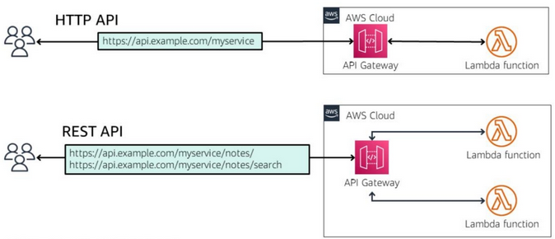
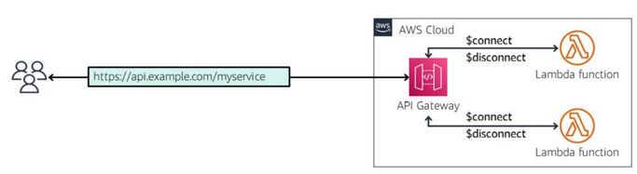

API Gateway Types

Slide 8
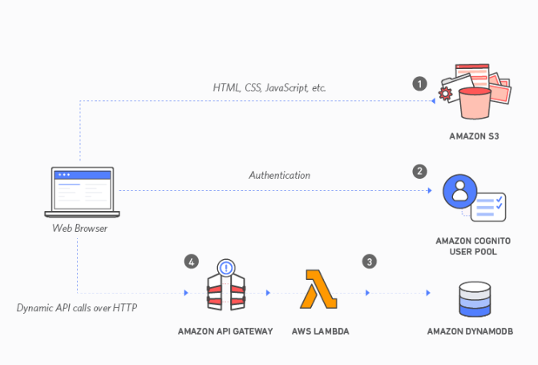
API Gateway Serverless application

Slide 9

API Gateway Demo in AWS Console

Slide 10

API Gateway Demo .NET Code

